Slide 1
Playlist recommendation based on logistic regression
Zhaxygalieyev Arsen

Slide 2
Intro
I have aim to create a program which will recommend me songs based on my musical tastes. many people face this problem when the playlist has not been updated for a long time, the songs are bored and you want to listen to something new but based on your preferences. Therefore, I tried to conduct my own research and implement a prediction system.

Slide 3
Current technologies used by Spotify, Apple Music
There are 3 ways:
1) Collaborative filtering
2) Natural Language Processing
3) Convolutional Neural Network

Slide 4
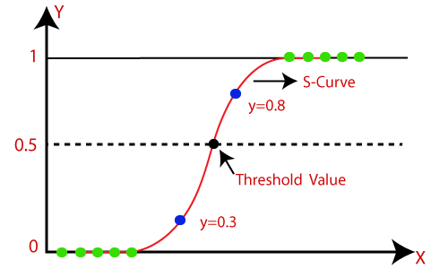
Logistic Regression
logistic regression is actually a classification technique that gives the probabilistic output of dependent categorical value based on certain independent variables.

Slide 5
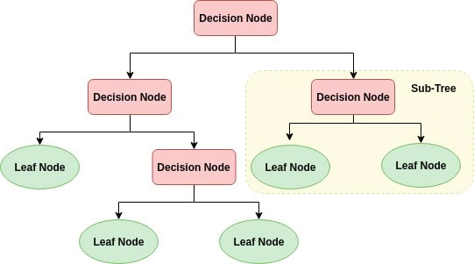
Decision tree algorithm
The general motive of using Decision Tree is to create a training model which can use to predict class or value of target variables by learning decision rules inferred from prior data(training data).

Slide 6
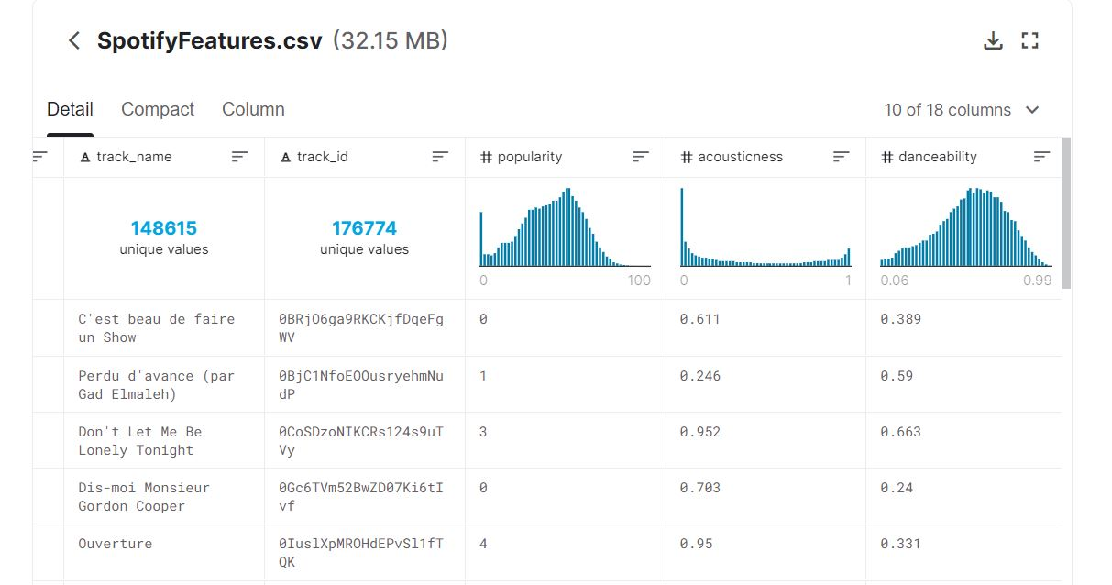
Dataset
https://www.kaggle.com/zaheenhamidani/ultimate-spotify-tracks-db

Slide 7
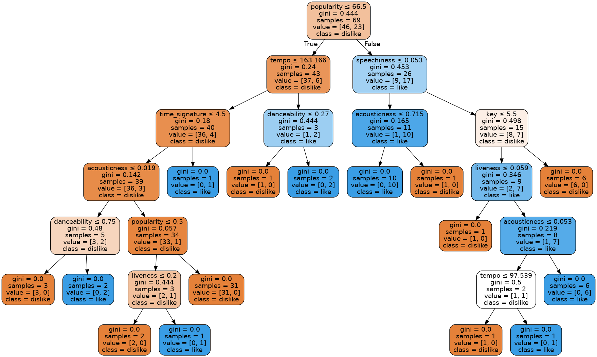
Comparison
Visualization of decision tree algorithm

Slide 8
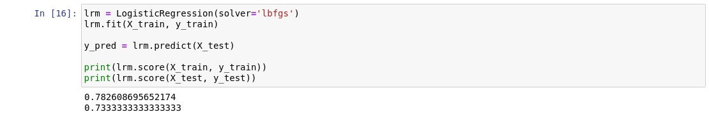
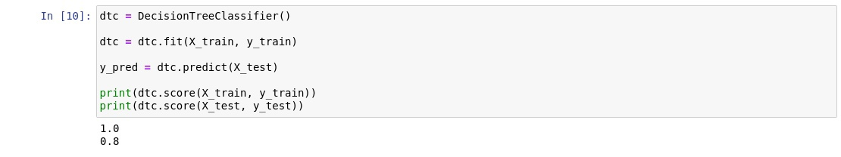
Logistic regression vs. decision tree
VS

Slide 9
Working principle
User must input 3 genres of favorite songs and 3 artists. After that system will suggest certain songs based on this preferences. In order to create a new playlist for the user, user should evaluate the song by like or dislike. Also he has an option to skip. Next, the system based on the preference of the user will output the new playlist for the user.

Slide 10
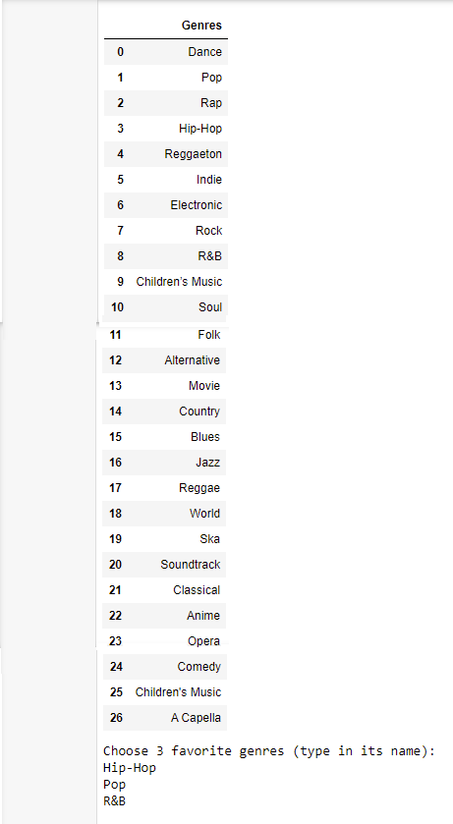
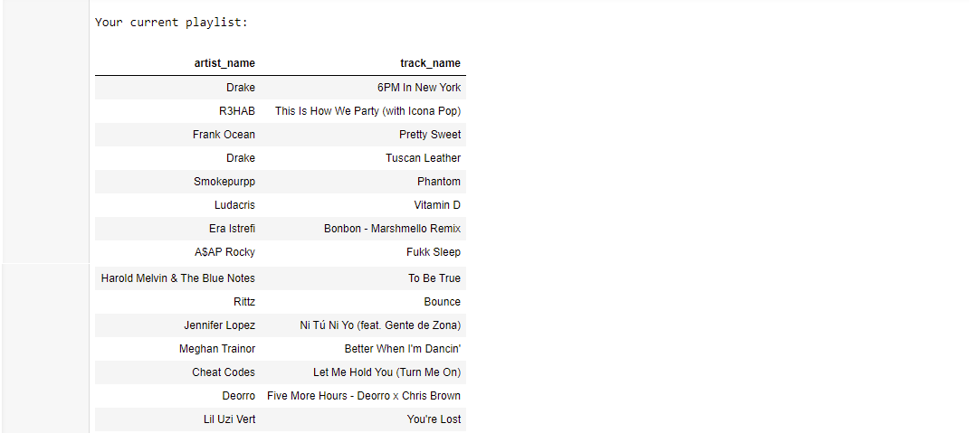
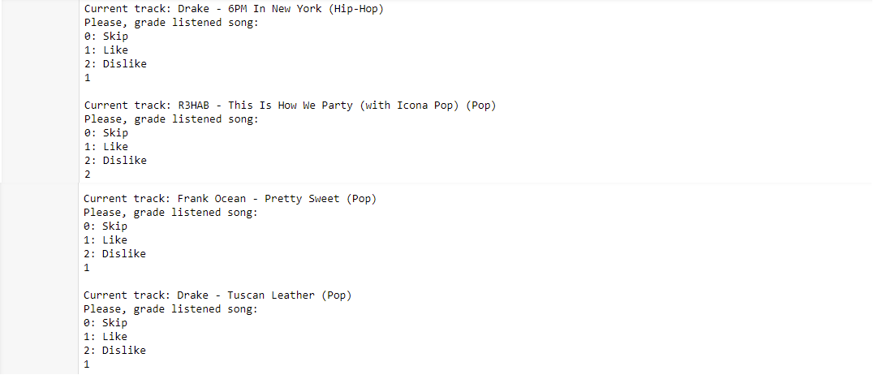
Selection of preferred genres
Current playlist representation
Evaluation

Slide 11
Conclusion
In conclusion, during this work logistic regression was investigated and then implemented into prediction songs. Also I have considered currently used technologies and methods in predictive systems of Spotify, Apple Music.

